Slide 1


An Investigation of Particulate Matter 2.5 in the District of Columbia During the COVID-19 Pandemic
DATA - 606: Capstone Project
Niko Darby, Snehika Pandey, and Tamrat Workineh
Advisor : Dr. Ozgur Ozturk
Fall 2021

Slide 2
Introduction
Particulate Matter 2.5 is a small particle such as dirt, soot, dust, or smoke that is about 2.5 ug/m3 LC (EPA, 2021). Particulate Matter 2.5 has been linked to COVID-19 and cancer:
Higher COVID-19 transmissions (Shafinaz et al., 2021; Comunian et al. 2020)
COVID-19 RNA has been found on PM2.5 fragments (Shafinaz et al., 2021; Comunian et al. 2020)
PM2.5 is also linked to the oncogenesis of various cancers (Shafinaz et al., 2021; Comunian et al. 2020)

Slide 3
Why PM 2.5 ?
The team is concerned with the increasing number of deaths of the target residents in DC due to COVID – 19.
Initiated this project to investigate if there is an association between PM2.5 and COVID - 19.

Slide 4
What Study Show:
“ Outdoor and indoor air pollution cause respiratory and other diseases and is an important source of morbidity and mortality. ” (WHO)
“ PM_{2.5}, PM₁₀ and NO₂, in COVID-19 spread and lethality ” (Cosimo et al, 2021;Shafinaz et al., 2021; Comunian et al. 2020)
Gaps:
Conducted research: WHO first investigated research methods - not all include confounding factors.
There is no research conducted specifically for the Washington DC metro areas .

Slide 5

Hypothesis
Trends of PM2.5 will show a decrease during the earlier periods of the COVID-19 pandemic and proceeding 2020, the PM2.5 concentrations will begin to increase due to elevated homosapien activity.

Slide 6
Goal::
Investigate PM2.5 with PM10, CO, SO2, and NO2 concentrations in the District of Columbia and predict the potential trends in 2021 onward and its impact on the COVID-19 pandemic.
Constructing a predictive model will aid in scrutinizing the trends of PM2.5 overtime (2021-2022 and onward) via a Django-based platform.
Examine if PM2.5 influences the increase or decrease of COVID-19 transmission rates - while also taking COVID-19 mortalities into consideration.

Slide 7

Project Description:
Sources: US –Environmental Protection Agency (US- EPA), Johns Hopkins University (JHU), and National Climate Data Center (NCDC)
Initially the dataset collected contained 879, 531 Columns and 29 Row:
EPA-NCDC Dataset Size: > 30,000 Data Points
JHU Dataset Size: > 800,000 data points

Slide 8
Features:
State Code Address Longitude Latitude Parameter_Occurrence Code Datum County Code Site Num Parameter Name Daily Max 8hr CO Conc. Daily Mean PM2.5 Conc. COVID-19 Deaths | Sample Duration Pollutant Standard Date Local Units_ of_ Measure Event Type Observation Count Observation Percent Date of Last Change AQI Method Code Daily Max 1hr NO2 Conc. Daily Max 1hr SO2 Conc. | Method Name Arithmetic Mean 1st Max Value 1st Max Hour Local Site Name State_ Name County _Name City Name Daily Mean PM10 Conc.

Slide 9
EDA: Data Cleaning and Manipulation
The collected dataset had many attributes some of which were irrelevant to data mining, or some are redundant., the study used attribute Subset Selection Method to reduces the volume of data by eliminating the redundant and irrelevant attribute.
Workable Datasets:
DeathIncrease: Monthly Death Rate of the target due to Covid
Ozone_ Contain: Monthly Ozone Concentration of Ozone
NO2_Contn: Monthly Ozone Concentration of Nitrogen Oxide
CO_ Concn: Monthly Ozone Concentration of Carbon Monoxide
Temp_ Avg: Monthly Ozone Concentration of Temperature
SO2 _Content: Monthly Ozone Concentration of Sulfur Dioxide
PM2.5_Contn Monthly Ozone Concentration of PM2.5

Slide 10
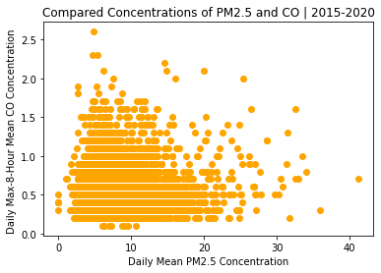
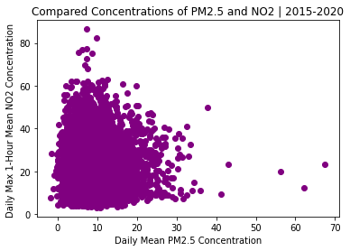
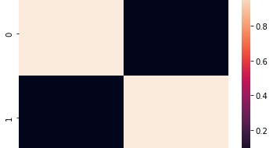
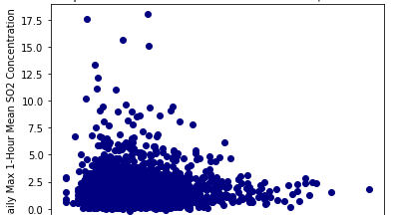
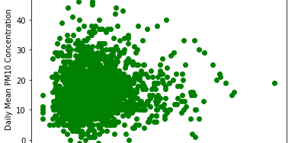
EDA: Patterns and Trends I

Slide 11
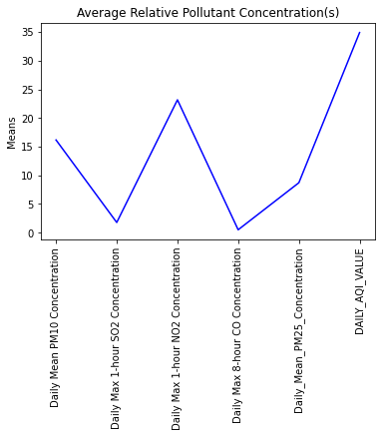
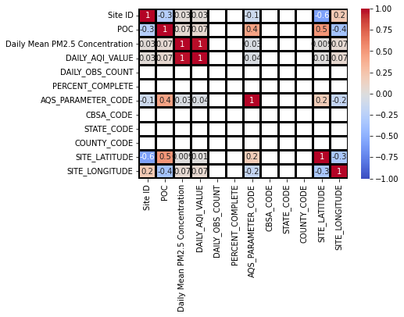
EDA: Patterns and Trends II

Slide 12
Method:
To evaluate PM2.5, PM10, CO, NO2, and SO2, on the Incidence and Mortality of COVID-19 in DC, based on historical data obtained from EPA, JHU and NCDC.
Utilized Data Visualization, Machine Learning, Predictive and Linear Regression models, and Correlation analysis on PM2.5, PM10, CO, NO2, and SO2.

Slide 13
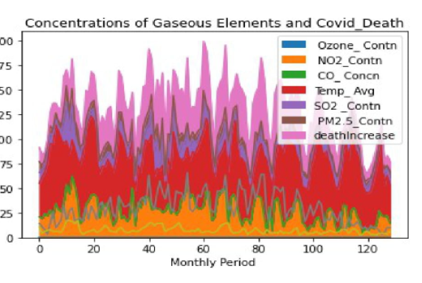
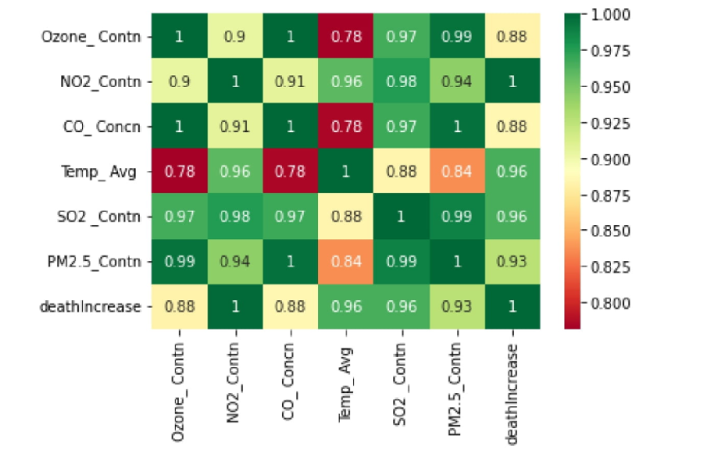
EDA: Patterns and Trends III
COVID-19 Deaths
COVID-19 Deaths
COVID-19 Deaths

Slide 14
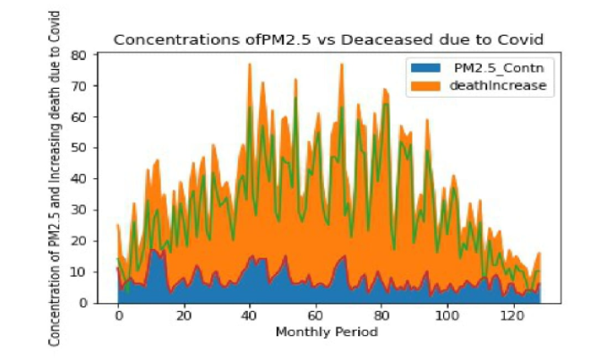
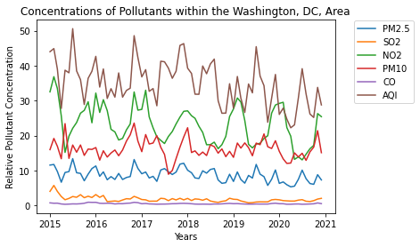
COVID-19 Deaths

Slide 15
Regression Analysis Model

Slide 16
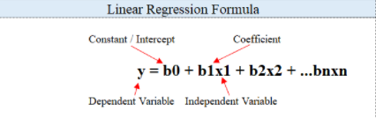
Why Regression Analysis Model ?
The team utilized different models, however, the regression analysis model provides detailed insight and a reliable method of identifying which variables have impact .
Furthermore , performing a regression allows you to confidently determine which factors matter most, which factors can be ignored, and how these factors influence each other.
Applying The regression equation for the linear model

Slide 17
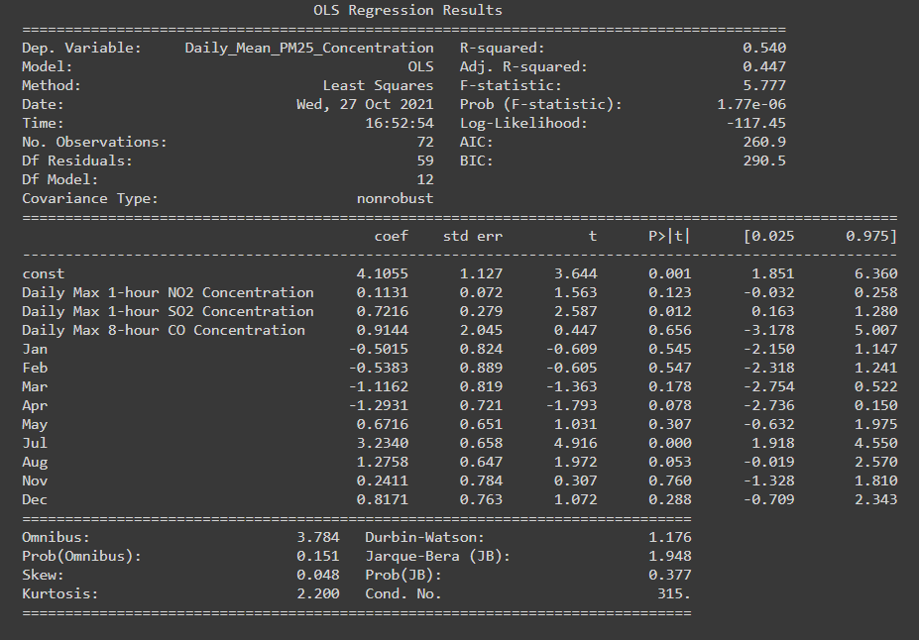
Evaluating the Regression Model

Slide 18
T
Taking PM2.5 as feature and Increase death due to Covid as a target
PM2.5 and Increase death due to Covid relationship
b₀ = ȳ - b₁x̄ x̄ = 24.0434 ȳ = 35.8837 b₀ = 35.8837 -0.7944*24.0434 = 16.7833
R Square (R²) equals 1.0
Correlation (R) equals 0.8777
It means that there is a very good direct relationship between the predictor and the predict

Slide 19
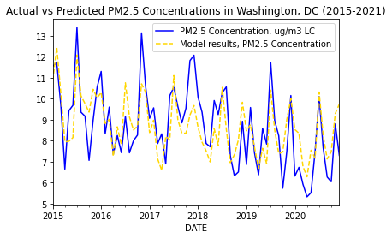
Visualizing the regression analysis result

Slide 20
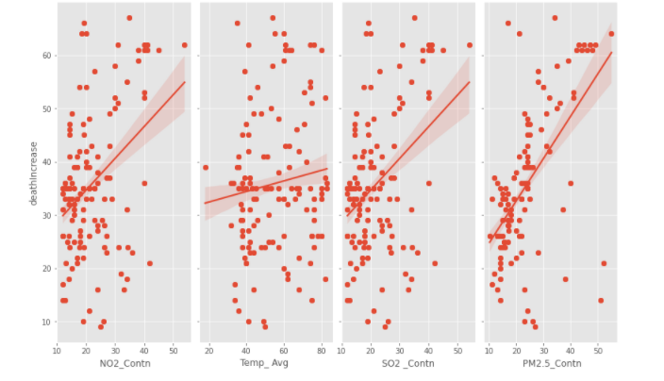
COVID-19 Deaths
Graphs showing the concentration of Ozone,N02,Temp ,SO2 ,PM2.5 and Death Increase due to Covid pandemic.

Slide 21
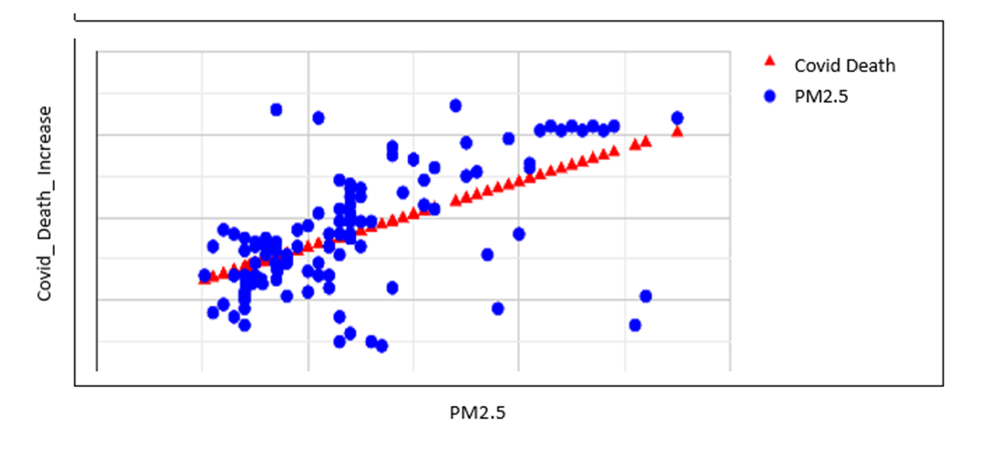
Regression Analysis: PM2.5 and COVID-19 Deaths

Slide 22
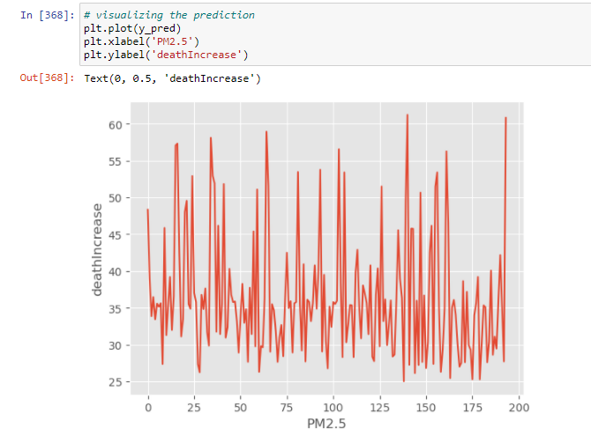

Slide 23
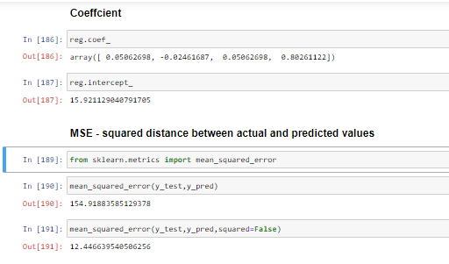
MSE ,R Square, Adjusted R Square, RMSE, MAE

Slide 24
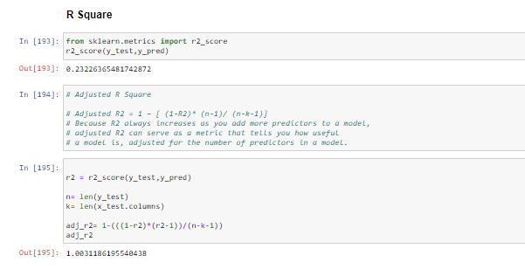

Slide 25
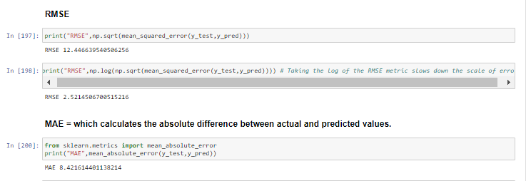

Slide 26
Conclusion:
The predictive models show that PM2.5 concentrations will increase during the latter and proceeding periods of 2020.
This supports our hypothesis that PM2.5 concentrations will be rather low during the earlier periods of the COVID-19 pandemic but increase during the later periods as human activity increases.
The Model also show a correlation between PM2.5 concentrations and Death due to Covid but may not be causation.

Slide 27
TIME TO VIEW THE PLATFORM

Slide 28
Next Steps:
During this study, we collaborated and constructed linear regression models to study the negative effects of pollution on our health .
We will further work on the same topic with additional resources and scope to discover results for the neighboring states of Maryland and Virginia.

Slide 29


